Slide 1

FPGA Support in the upstream kernel
Alan Tull
November 2, 2016

Slide 2
Overview
Added in v4.4
  FPGA Manager framework
  Low level drivers for CycloneV and Zynq (thanks Moritz!)
On the mailing list
  Device Tree Overlay and bridges support
  FPGA Manager changes
  Support for more FPGAs
    Arria10 partial reconfig support
    Lattice iCE40 Family SPI (Joel Holdsworth)
    Cyclone V SPI (Joshua Clayton)
In development, not yet posted
  Altera support for PCIe FPGAs (Matthew Gerlach)

Slide 3
FPGA Manager Framework
Manufacturer-agnostic in-kernel API for programming FPGAs
Only handles programming
The intention is that higher level layers/interfaces can be implemented that may be used with any FPGA
Low level drivers to handle FPGA particulars are registered with the framework
API has 6 functions:
  Register/unregister low level driver
  Get/put a FPGA manager from device node
  Program FPGA from a buffer or from a firmware file
  Plus one on mailing list now: Get FPGA manager from device

Slide 4
FPGA Regions and FPGA Bridges
Adds Device Tree Overlay support for programming FPGAs
DT Overlay notifications
Hierarchy of FPGAs, FPGA Regions, and Bridges in the Device Tree
  A base image in FPGA can create FPGA Regions (like slots) for Partial Reconfiguration
  FPGA Bridges can be hard hardware or soft hardware in the FPGA
  Bridges are disabled and frozen during programming to protect CPU busses and FPGA logic from junk
Each PR region has have a bridge to control busses independently.
  While one region is being programmed, other regions continue to be active and their drivers don’t have to be unloaded.
Can use Pantelis Antoniou’s DTO ConfigFS interface for applying DTO’s

Slide 5
FPGA Regions
Each region gets its own split of the busses, gated by a bridge.
Processor
FPGA
FPGA Manager HW
Programming Interface
FPGA Fabric
Bridge
PR Region
Bridges
Bridge
PR Region

Slide 6
FPGA programming by applying a Device Tree Overlay (DTO)
DTO contains:
  Target FPGA Region
  Bridges
  FPGA Image firmware file name
  Image specific information
  Child devices
When DTO is applied:
  Bridges are disabled
  FPGA is programmed
  Bridges reenabled
  Child devices probed
When DTO is removed
  Child devices removed
  Bridges disabled

Slide 7
A few words about interfaces
The FPGA Manager framework has no userspace interface by design
  I have patches for a simple DebugFS, haven’t submitted yet.
I don’t think that there is one interface or set of higher layers that will be appropriate for all FPGA use cases
The FPGA Regions code (when used with the Overlays ConfigFS interface) adds one interface with some good features. It won’t fill everyone’s needs (not all platforms use Device Tree).
Whatever interfaces and higher layers are added on top of FPGA Manager, all the supported FPGAs will have the opportunity to use

Slide 8
FPGA Image Info Struct (change to the FPGA Manager framework)
FPGA images may have particulars that affect how they are programmed
  Image built partial or full reconfiguration
  How long to wait for the bridges to disable/enable traffic
  How long to wait for FPGA to go to operating mode after programming
struct fpga_image_info added to API to contain these
Struct can be populated from DT or from… somewhere else.
API change is easy:
  Current upstream API contains a u32 flags
  Change to API is to take out the u32 flags and put a pointer to this struct instead.

Slide 9
Reference
FPGA Manager in the kernel lives here:
  drivers/fpga
  include/linux/fpga
  documentation/fpga
  documentation/devicetree/bindings/fpga
V21 repost of Device Tree Overlay support for FPGAs (look for Tull)
  https://lkml.org/lkml/2016/11/1
In particular, here’s the doc for FPGA Regions
  https://lkml.org/lkml/2016/11/1/383

Slide 10


Back Up

Slide 11
Backup

Slide 12
FPGA Manager API (with proposed changes)
Register Low Level Drivers:
  int fpga_mgr_register(struct device *dev, const char *name, const struct fpga_manager_ops *mops, void *priv);
  void fpga_mgr_unregister(struct device *dev);
Get/Put
  struct fpga_manager *of_fpga_mgr_get(struct device_node *node);
  void fpga_mgr_put(struct fpga_manager *mgr);
  (on list) struct fpga_manager *fpga_mgr_get(struct device *node);
Program a FPGA
  int fpga_mgr_buf_load(struct fpga_manager *mgr, struct fpga_image_info *info, const char *buf, size_t count);
  int fpga_mgr_firmware_load(struct fpga_manager *mgr, struct fpga_image_info *info, const char *image_name);

Slide 13
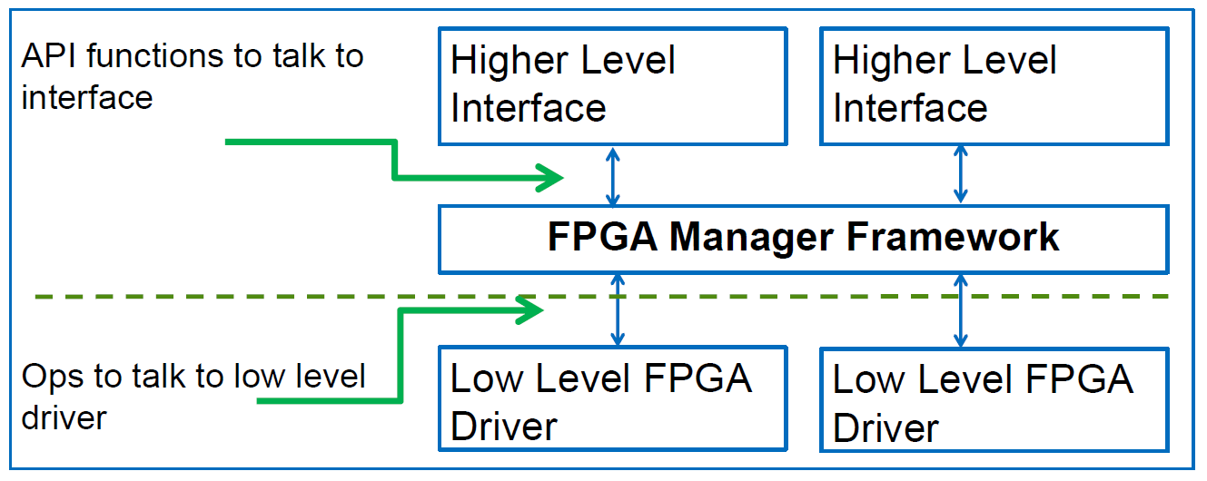
The Linux Kernel FPGA Manager Framework

